Slide 1
SIMPLE CONTACT MANAGEMENT (CM)PROJECT
A SIMPLE WEB PROJECT DESIGNED TO TRACK USER’S CONTACTS SIMILAR TO PHONEBOOK.

Slide 2
INTRODUCTION
The simple web application diagram
Backend (server) Languages and Frameworks
(Object Relational Mapper) ORMs and Plain SQL
Databases
Frontend (client) Languages and Frameworks
CM’s web application design

Slide 3
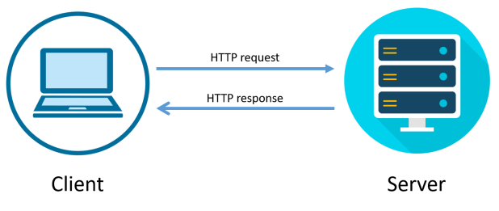
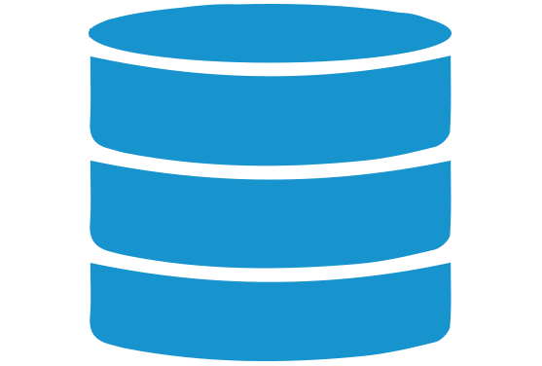
THE SIMPLE WEB APPLICATION DIAGRAM
request-response cycle
Queries
Database

Slide 4
BACKEND OR SERVER LANGUAGES
Programming language | Features | Advantages | Limitations
Javascript | Object-oriented(OOP), Interpreted scripting language, Lightweight | Used for both backend and frontend development, Platform independent | No multithreading and multiprocessing, No networking support
Python | Object-oriented(OOP), Interpreted scripting language, Less verbose | Great for rapid prototype development, Tremendous standard and external library support, platform independent | Slower execution speed, Uses a lot of memory, and weak for mobile computing
Java | Object-oriented(OOP), Compiled (javac) and interpreted (JVM), Secure language | Supports multithreading, Mature language with extensive community support, platform independent | Platform independence is less important for modern application dependency because of containers and cloud services, Poor memory management and JVM affect performance. Slower than C, C++, and C#, and Verbose and complex code

Slide 5
BACKEND FRAMEWORKS
Frameworks are used by developers to make it easy for them to rapidly develop software applications.
Frameworks | Advantages | Disadvantages
Django | ORM support, Great Performance, High Security | Not suitable for small projects, Prior knowledge required
FastAPI | Automatic docs, Async programming, and Easy, Short, Fewer bugs and Great with small projects, Decent security | Community
Flask | Minimalistic, Lightweight, Beginner Friendly, Great with small projects | Security, Community

Slide 6
DATABASE MANAGEMENT SYSTEMS (DBMS)
A Database Management System (DBMS) is a specialized software designed to store, retrieve, and manipulate data. It acts as a mediator between the database, applications, and user interfaces to manage and organize data effectively.
A relational database management system (RDBMS) is an information repository that organizes data into tables consisting of rows (records) and columns (attributes that contain the properties of these records).
comparison of some database management systems:-
DBMS | Database type | Licensing | Scalability
MySQL | SQL | GNU Generally public license | Vertical complex
PostgreSQL | Object relational SQL | Open-source | Vertical
SQLite | SQL | Public domain | Vertical
Structured Query Language (SQL) are used to manipulate the data in a database.

Slide 7
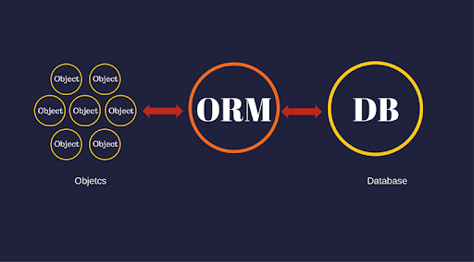
(OBJECT-RELATIONAL MAPPER)ORMS
The logic behind Object Relational Mapping is being able to write queries and manipulating data using an object-oriented paradigm. It gives an opportunity to deal with a database by using our language (which in this project we mentioned Python) instead of SQL.
Advantages | Disadvantages
It might save a lot of time for whom don’t write in SQL much. | For whom that is good at SQL, using ORM can be less efficient and useful.
ORM makes switching between various relational databases(e.g. from MySQL to PostgreSQL) much easier. | In general, it would lead you be less capable to erase the problems.
Some of the queries will perform better than if you wrote them yourself. | The extra conflicts can appear when setting configuration and so on.

Slide 8
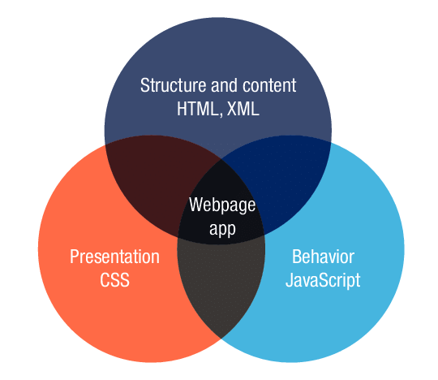
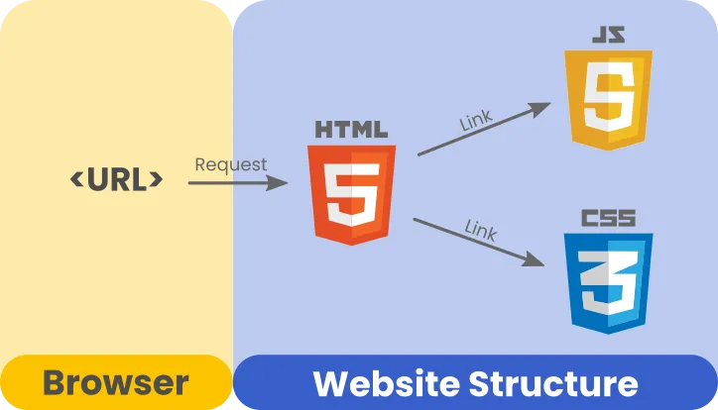
FRONTEND LANGUAGES
In the frontend there is only top 3 most stable languages available which are used simultaneously:-
CSS (Cascading style sheet)
HTML (Hypertext markup language)
Javascript (Programming language)

Slide 9



FRONTEND FRAMEWORKS
Fontend Frameworks helps the developer to develop UI faster with less code.
React
Angular
Vue

Slide 10



(CONTACT MANAGEMENT) CM’S WEB APPLICATION
Port 8000
Port 3000
Response
Path operations
Router
Schemas
CRUD
Request by fetch
Cient
Server
Engine + connection
ORM sessions
ORM models
Database

Slide 11
THE END

Slide 12
CM’S DATABASE DIAGRAM

Slide 13
CM’S BACKEND ARCHITECTURE
Backend
main
app
API
database service
auth
app service
contacts
models
schemas
router
service
models
schemas
router
service

Slide 14
CM’S FRONTEND (UI/UX) ARCHITECTURE

